Slide 1
Engineering Ethics
CSE 593
Dr. Yinong Chen

Slide 2
Contents
1
Introduction to Engineering Ethics
2
Ethics Theories
3
Ethics Application
4
Case Studies

Slide 3
The Engineering Design Process
1
Define
Problem
Evaluate
Performance
Dependability
Cost
Right or Wrong
2
Generate
Solutions
Evaluate
Modeling
Ethics Theories
3
Decide the Course of Action
Evaluate
5
Evaluation
4
Implement Solution

Slide 4
Societal Normative Systems
Ethics
Ethics
Moral
Law

Slide 5
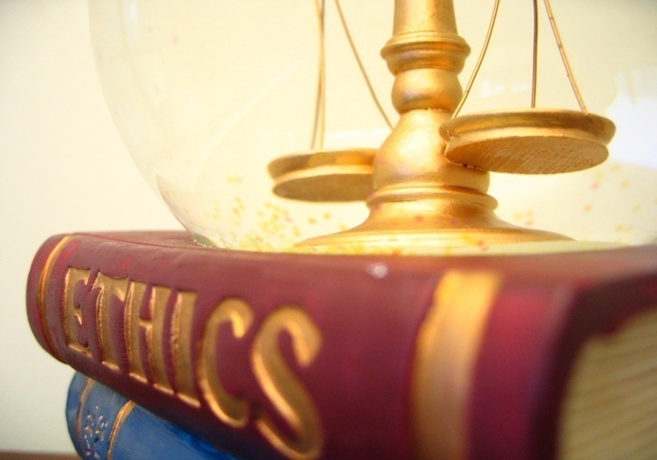
Ethics…
Rules, principles, or standards that govern the conduct of the person or the conduct of the members of a profession!

Slide 6
Subdivisions of Ethics
In Engineering
In Computer Science
Applied Ethics
In Business
Rights
Normative Ethics
Virtue
Utilitarianism
Meta-Ethics
Kantianism
Culture Relativism
Subjective Relativism
Divine Command Theory

Slide 7
Ethics
Ethics has three main subdivisions:
  Meta-ethics: Deals with the origin, purpose, and nature of ethical evaluations (not deciding what is right & wrong)
  Normative ethics: Objective is to determine how to identify right from wrong, and how to make ethical decisions
  Applied ethics: Applies principles of normative ethics to particular subjects or topics (e.g., business ethics, engineering ethics, ethics of abortion or other current issues, etc.)
Many ethical issues overlap all three branches of ethics; distinction is not always clear

Slide 8
Meta-Ethics
Meta-ethics or analytical ethics: theoretical study that
  inquires into semantic, logical, and epistemological issues in ethics.
  It investigates the meaning of ethical terms, the nature of value judgments, and
  The justification of ethical theories and judgments:

Slide 9
Normative Ethics

Slide 10
Normative Ethical Theories
Normative ethics has several major, competing approaches:
  Kantianism ethics (by Immanuel Kant: duty, moral obligations, deontology): Focuses on individual duties or obligations; an act may be wrong even if it leads to the best possible outcome
  Rights ethics (John Locke): Focuses on the rights of the individual
  Utilitarianism or Consequential ethics (teleology) (John Stuart Mill): Focuses on achieving the greatest good for the greatest number of people. Emphasizes the consequences of an act rather than considering individual duties or rights. Can be criticized for its view that “the ends justify the means”
  Virtue ethics (Aristotle): Focuses on building the character of an individual, and the way they should behave
These approaches are complementary; different situations may call for the application of different or multiple approaches

Slide 11
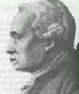
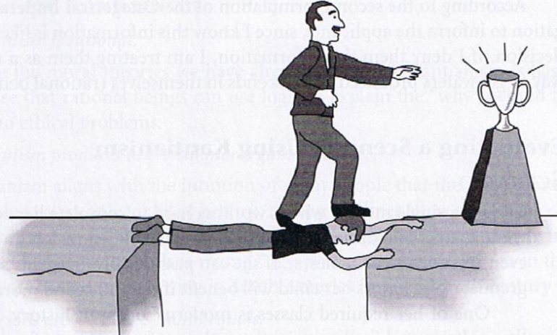
Kantianism Ethics
Duty
“Always treat humanity, whether in yourself or in other people, as an end in itself and never as a mere means.”
Act only from moral rules, which are universal moral laws and duty.
Deontological Ethics
(deon = duty)
Immanuel Kant
1724-1804
[Ethics, M. Quinn, 2008]

Slide 12
Utilitarianism Ethics
Utilitarianism
Get a balance between the good and bad consequences of an action
Balance the needs of individual with the needs of society that will provide the most benefit to the most people
What’s best, in general, for everyone?

Slide 13
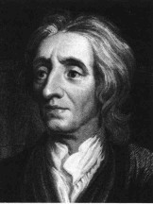
Rights Ethics
Rights
Do not violate people’s moral rights
“Humans have a right to life, liberty and property”
Respect individuals and protect the rights of others
Duty Ethics and Rights Ethics:
  Duty: More on the right of majority
  Rights: Everyone’s right
John Locke
1632-1704

Slide 14
Virtue Ethics (by Aristotle)
Virtue
Virtue = “goodness”
  Intellectual virtue, developed through education
  Moral virtue, coming from repetition of the appropriate acts
Virtue ethics are about happiness through character—and the type of person we should strive to be
Actions are considered right if they support good character traits (virtues)
And wrong if they support bad character traits (vices)
A weakness is that it can allow the justification of injustices.

Slide 15
Virtue Ethics (by Aristotle)
Virtue
Virtues (good characters) that result in happiness include
  Benevolence
  Civility
  Compassion
  Conscientiousness
  Cooperativeness
  Courage
  Courteousness
  Dependability
  Fairness
  Friendliness
  Generosity
  Honesty
  Industriousness
  Justice
  Loyalty
  Moderation
  Patience
  Prudence
  Reasonableness
  Self-disciplined
  Self-reliance
  Tactfulness
  Thoughtfulness
  Tolerance

Slide 16
Applied Ethics
Professionalism and
Code of Ethics

Slide 17
Ethics & Professionalism
Professional and ethical considerations should not restrain creativity in brainstorming ideas.
Some of these “outrageous” ideas can lead to really good ideas.
In your final work, you must rule out those ideas that are unethical, unprofessional, or illegal.
Notes:
Z:15

Slide 18
Professional Ethics and Relations
Other companies
Professional Societies
Clients
Working Environment
Family obligation
Engineers
Colleagues
Managers

Slide 19
The National Society of Professional Engineers (NSPE)
(ASU Fulton School Engineering)
Purposes of the Society:
  1. Promotes licensure and ethics
  2. Enhances engineering image
  3. Protects legal rights of professional engineers (PE’s)
  4. …and much more..

Slide 20
NSPE Rules of Practice
http://www.nspe.org/Ethics/CodeofEthics/index.html
Engineers shall hold paramount the safety, health, and welfare
Engineers shall perform services only in the areas of their competence for the public.
Engineers shall issue public statements only in an objective and truthful manner.
Engineers shall act for each employer or client as faithful agents or trustees.
Engineers shall avoid deceptive acts.

Slide 21
ACM Code of Ethics and Professional Conduct
http://www.acm.org/about/code-of-ethics
1. General Moral Imperatives
1.1 Contribute to society and human well-being
1.2 Avoid harm to others
1.3 Be honest and trustworthy
1.4 Be fair and take action not to discriminate
1.5 Honor property rights including copyrights and patents
1.6 Give proper credit for intellectual property
1.7 Respect the privacy of others
1.8 Honor Confidentiality

Slide 22
IEEE Code of Ethics
http://www.ieee.org/portal/pages/iportals/aboutus/ethics/code.html
To accept responsibility in making engineering decisions consistent with the safety, health and welfare of the public, and to disclose promptly factors that might endanger the public or the environment;
To avoid real or perceived conflicts of interest whenever possible, and to disclose them to affected parties when they do exist;
To be honest and realistic in stating claims or estimates based on available data;
To reject bribery in all its forms;
To improve the understanding of technology, its appropriate application, and potential consequences;

Slide 23
IEEE Code of Ethics
http://www.ieee.org/portal/pages/iportals/aboutus/ethics/code.html
to maintain and improve our technical competence and to undertake technological tasks for others only if qualified by training or experience, or after full disclosure of pertinent limitations;
to seek, accept, and offer honest criticism of technical work, to acknowledge and correct errors, and to credit properly the contributions of others;
to treat fairly all persons regardless of such factors as race, religion, gender, disability, age, or national origin;
to avoid injuring others, their property, reputation, or employment by false or malicious action;
to assist colleagues and co-workers in their professional development and to support them in following this code of ethics

Slide 24
Engineering Failures, Accidents, and Investigation

Slide 25
Computer-Related Risks
Problems involving:
Reliability
Safety
Security
Privacy
Disasters
Book: Computer-Related Risks by Peter Neumann
(Addison-Wesley 1994; ACM Press Series)

Slide 26
The baggage-handling system of the Denver International Airport
Errors in the software that controls the system required postponement of the official opening (Oct. 1993).
By June 1994 the $193 million system was
still not functioning, but costing $ 1.1 million per day in interest and other costs.
In early 1995 a manual baggage system was installed in order to open the airport.

Slide 27
Therac-25
Therac-25 is a computer controlled radiation-therapy machine;
Some cancer patients in the Canada, France, and USA have received fatal radiation overdoses from the Therac-25;
The problem was traced to the synchronization problem among parallel threads: If the operator is fast, the execution sequence will be correct, but…

Slide 28
Sizewell B nuclear power plant in England
Some years ago it was decided to test the subsystem which is used to close down the reactor if a dangerous situation occurs.
The results were not comforting: the software failed almost half of them.
They were not able to find the errors in the 100 000 lines of code.
Instead, they reduced the overall expectation of the plant's dependability from one failure every 10,000 years to one every 1,000 years.

Slide 29
Computer-Related Incidents with Aircraft
The Korean Air Lines B747 CFIT Accident in Guam (1997)
The FedEx MD11 Accident on Landing at Newark (1997)
The Birgen Air B757 accident near Puerto Plata (1996)
News on the Aeroperu B757 accident (1996)
The Ariane 5 Failure (1996)
The T-43A Accident near Dubrovnik (1996)
Information About the Martinair B767 EFIS-loss Incident near Boston, MA
The American Airlines B757 Accident in Cali (1995)
The A320 Maintenance Incident at Gatwick (1995)
The A330 Flight-Test Accident in Toulouse (1994)
The Tokyo-London A340 FMGS Problem (1994)

Slide 30
Ariane 5 Flight 501 Disaster
June 4, 1996

Slide 31
European Space Agency's
Ariane 5 Flight 501 Disaster
Flight 501 took off on June 4, 1996;
It was the first test flight of the Ariane 5 expendable launch system.
The rocket tore itself apart 37 seconds after launch;
The breakup caused the loss of the payload: four Cluster mission spacecraft;
It was caused by a malfunction in the control software,
One of the most expensive computer bugs in history: $500 million, uninsured!

Slide 32
Cause of the Failure
The Ariane 5 software reused the code from the Ariane 4;
Ariane 5 was heavier, its flight path was considerably different and beyond the range for which the reused code had been designed;
A data conversion from 64-bit floating point to 16-bit signed integer value caused an overflow, which leads to the internal Inertial Reference System software exception;

Slide 33
Cause of the Failure
The floating point number which was converted had a value greater than what could be represented by a 16-bit signed integer;
For the previous version, Ariane 4, the number did not exceed the capacity of 16 bits.

Slide 34
Ada Code That Course the Crash
Float of 64 bits
declare
vertical_veloc_sensor: float;
horizontal_veloc_sensor: float;
vertical_veloc_bias: integer;
horizontal_veloc_bias: integer;
...
begin
declare
pragma suppress(numeric_error, horizontal_veloc_bias);
begin
sensor_get(vertical_veloc_sensor);
sensor_get(horizontal_veloc_sensor);
vertical_veloc_bias := integer(vertical_veloc_sensor);
horizontal_veloc_bias := integer(horizontal_veloc_sensor);
...
exception
when numeric_error => calculate_vertical_veloc();
when others => use_irs1();
end;
end irs2;
Integer of 16 bits
Type casting from float to integer

Slide 35
Who is to Blame?
Reuse of software without sufficiently checking the specification
The requirement that the horizontal bias should fit in 16 bits was stated in an obscure part of a document.
But in the code itself it was nowhere to be found:
  At least, it should have been written this critical requirement as comments;
  It should write code to handle the exception, e.g.,
  if (vertical_veloc_sensor >= 2¹⁵) or (vertical_veloc_sensor =< 2¹⁵), then …. (enter a safe flight state)

Slide 36
Causes of Engineering Disasters
Human factors
Design flaws
Material failures
Extreme conditions or environments
Combinations of the above

Slide 37
Engineering Failure Causes
When engineers were at fault, causes of failure were:
  Insufficient knowledge 36%
  Underestimation of influence 16%
  Negligence 14%
  Forgetfulness, error 13%
  Reliance upon others without sufficient authority 9%
  Objectively unknown situation 7%
  Imprecise definition of responsibilities 1%
  Choice of bad quality items or materials 1%

Slide 38
Summary
Different ethics theories
  Kantianism (Duty) Ethics
  Rights Ethics
  Utilitarianism Ethics
  Virtue Ethics
Professional Ethics, particularly, in computing
  NSPE (ASU Fulton School Engineering)
  ACM / IEEE
Engineering failures and risks

